Slide 1

Revolutionizing the Hiring Process
AI-Powered Applicant Tracking System
Team Members: Vishaka Pahuja & Mohammad Yaqoob
Supervisor: Sir Rizwan Abro
Sukkur IBA University

Slide 2

Introduction
NextGenATS is an AI-powered tool that makes hiring easier and faster. It helps companies by automatically reviewing resumes, scoring candidates, and scheduling interviews

Slide 3

Purpose
💻 Create an AI-driven tool for HR teams
🤖 Automate tasks to streamline processes
💬 Improve the candidate experience
📊 Handle large volumes of applications efficiently

Slide 4
Problem Statement
01
02
03
04
05
06
Hiring is time-consuming and labor-intensive.
High application volumes make manually screening hard.
Early hiring bias harms diversity and decision quality.
Companies need an efficient, unbiased system to find top candidates.
Delays and lack of feedback can give job seekers a poor impression of the company.
Manual hiring is costly in time, resources, and vacancies.

Slide 5
Proposed Solution - ATS
AI-driven resume parsing and scoring.
Automated assessment generation based on job requirements.
Streamlined interview scheduling for top candidates.
Provides immediate feedback to applicants, reducing waiting time.
Reduces bias by focusing on data-driven evaluations.

Slide 6
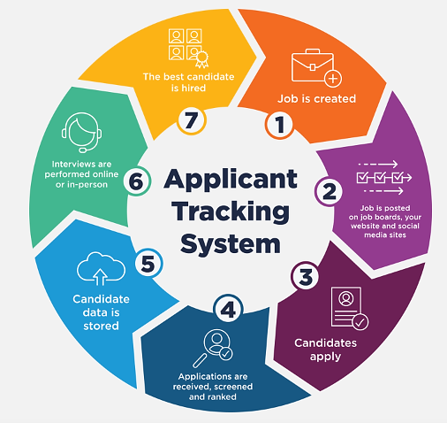
Working

Slide 7







Technologies Used
Frontend
Backend
HTML, CSS, JavaScript
Flask/ Django
AI
Database
NLP/Machine Learning
Firebase/MongoDB

Slide 8
References
Author | Paper Name | Conclusion
K Sri Surya Reguri Sharanya | Smart Applicant Tracking System using Gen AI | Google Gemini's AI capabilities revolutionizes the resume shortlisting process
Ankit Tiwari1, Sagar Vaghela2, Rahil Nagar3, Mrunali Desai4 | Applicant Tracking and Scoring System | NLP and scoring make resume evaluation more aligned with specific hiring needs
Hanqing Zhang, Haolin Song, Shaoyu Li, Ming Zhou, Dawei Song | A Survey of Controllable Text Generation Using Transformer-based Pre-trained Language Models | Controllable Text Generation using Transformer-based models offers promising advancements

Slide 9
Thanks!

